Slide 1



DATA SCIENCE SALARY PREDICTION
By Lisa H Huynh

Slide 2
ANALYSIS OBJECTIVE
Find the valuable insights into the current salary trajectories
What are the top 10 Highest Annual Salaries with Job Titles?
Examine a myriad of factors and their complex interconnections with the aim of predicting salary outcomes
Use machine learning and dataset that contains information on data science job salaries to features factors.
Do paid salaries related to experience level?
The correlation of average salary to job type?

Slide 3
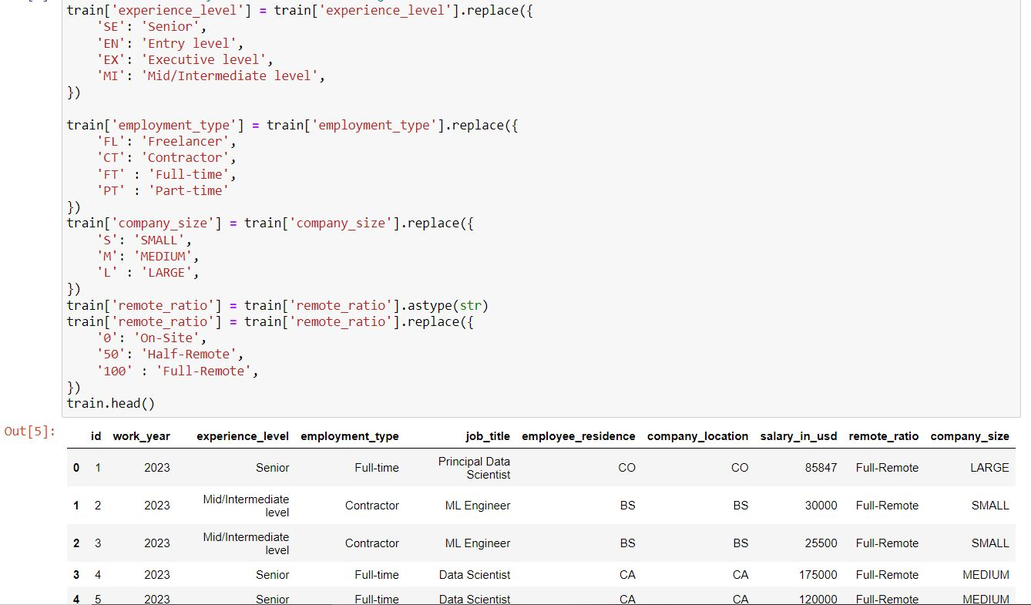
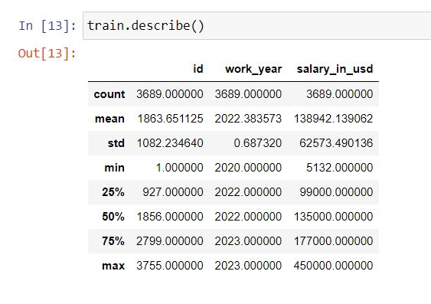
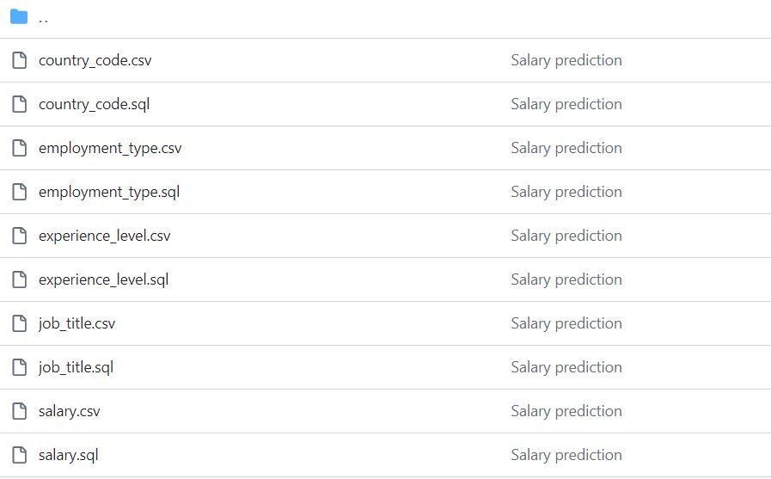
DATA SET
Data Science Job Salaries Dataset contains 11 columns.
Data is sourced from Kaggle and normalized into separate SQL tables Salary_in_currency is dropped while converting.

Slide 4
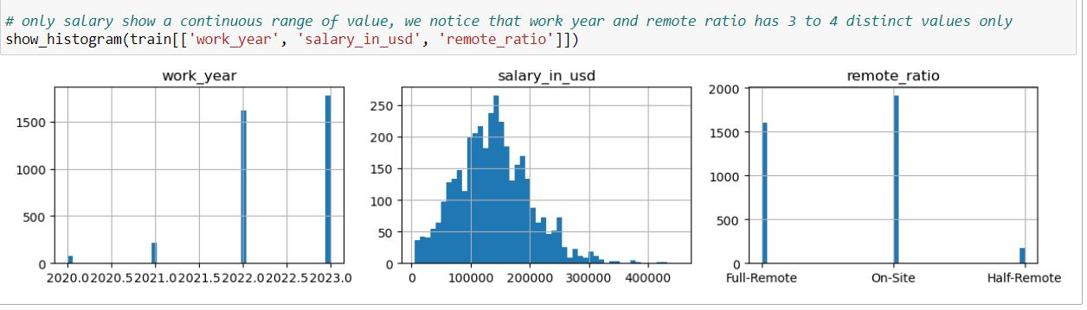
Utilize histograms to find which values are most common and which values are least common: "work year“: Wages in 2023 is higher growth than in other years "salary in USD“: The range from $150,000 is paid popularly "remote ratio”: On-site jobs take most of the job types in this industry.

Slide 5
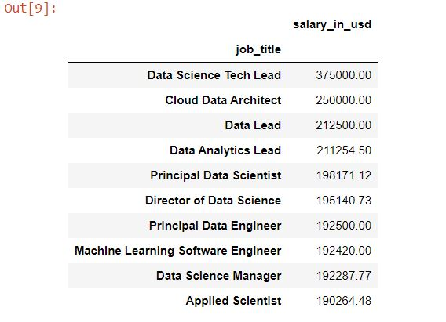
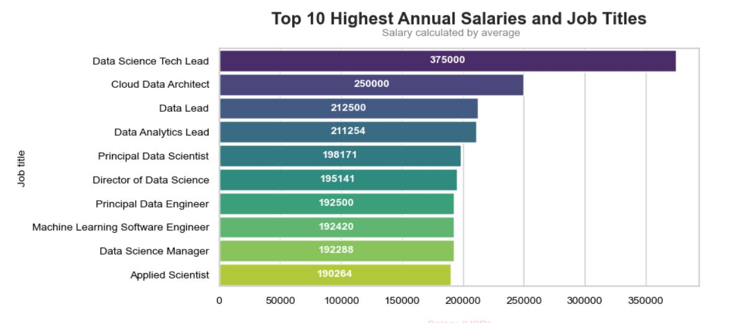
Top 10 Highest Annual Salaries with Job Titles
The result of the chart shows that top highest annual salary with job titles is Data Science Tech Lead ( $375,000/year)

Slide 6
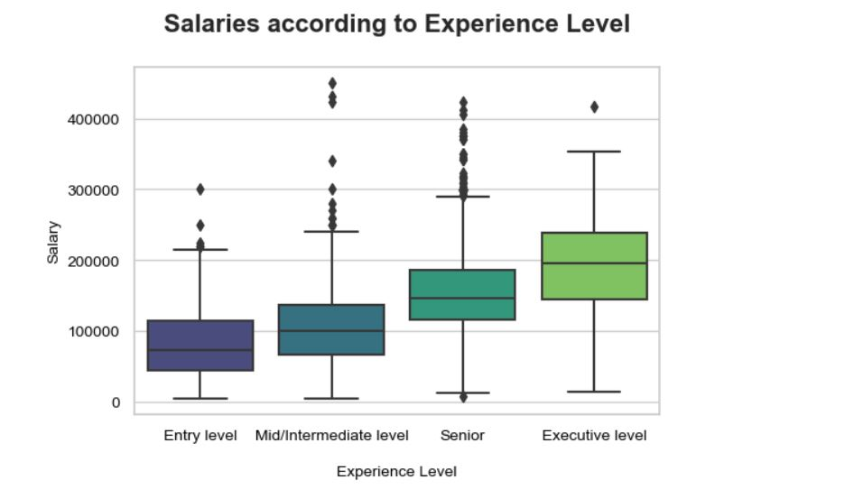
Salaries according to Experience Level

Slide 7
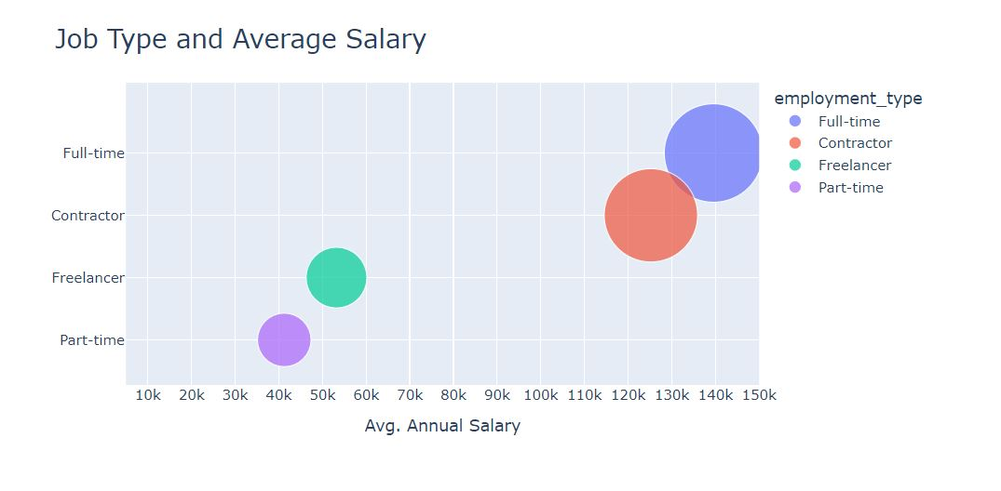
The bubble chart performed employment type of Full-time made the highest average salary

Slide 8
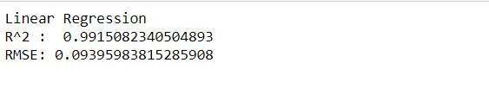
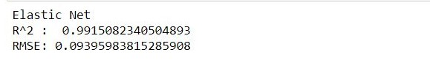
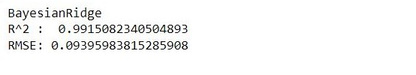
MAKE PREDICTION
Use several algorithms to test R-Square score:
Score of Linear Regression
Score of Elastic Net
Score of Bayesian Ridge

Slide 9
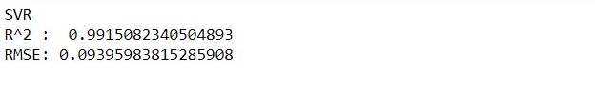
MAKE PREDICTION
Use several algorithms to test R-Square score:
Score of classification SVR
Score of Gradient Boosting Regressor

Slide 10
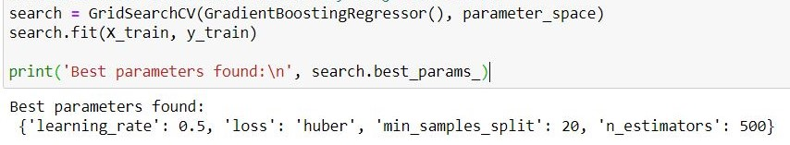
Hyperparameter Tuning Gradient Boosting Regressor
The default parameters are the most sensible ones. Hyperparameter Tuning is upgraded from Elbow method to optimize the score. It’s the best parameter to improve the score in this case.

Slide 11
Analysis result
Based on several algorithms showed R-score:
Elastic Net: 0.99*
Bayesian Ridge Algorithm: 0.99
Gradient Boosting Algorithm: 0.99
SVR Algorithm: 0.99
Linear regression: 0.99
R-square scores: 0.99
All are close 1 is good to tell us these factors are strongly relative. Linear regression analysis revealed that job title, experience level, employment type, company size are robust predictors of salary. These models are expected to provide more accurate results datasets.
Additional result :
Through Histogram:
"work year“: Wages in 2023 is higher growth than in other years
"salary in USD“: The range from $150,000 is paid popularly*
"remote ratio”: On-site jobs take most of the job types in this industry.
The result of the chart shows that top highest annual salary with job titles is Data Science Tech Lead ( $375,000/year)
The bubble chart performed the employment type of Full-time made the highest average salary.

Slide 12
THANK YOU

